Slide 1


Grounds-up LLM Development
Ayush Maheshwari, Manish Modani Sr. Solutions Architect, Principal Solutions Architect https://github.com/ayushbits/llm-development ayushbits.github.io

Slide 2
Sessions
Large scale data curation for LLM training
Large scale data curation for LLM training (1 hour)
Understanding the hardware (30 mins)
GPU vs CPU
GPU communication primitives
System Topology
Large scale data curation for LLM training (1 hour)
Deep-dive into aspects of data curation
Hands-on data curation
BREAK (10 mins)
Distributed and stable LLM training on a large-scale cluster (1 hour)
Parallelism techniques
Frameworks and wrappers
Recipes and best practices
Inference (15 mins)
Inference with build.nvidia.com
Synthetic data generation

Slide 3

Register for GTC 2026
https://tinyurl.com/nvgtc2026
Scan QR

Slide 4
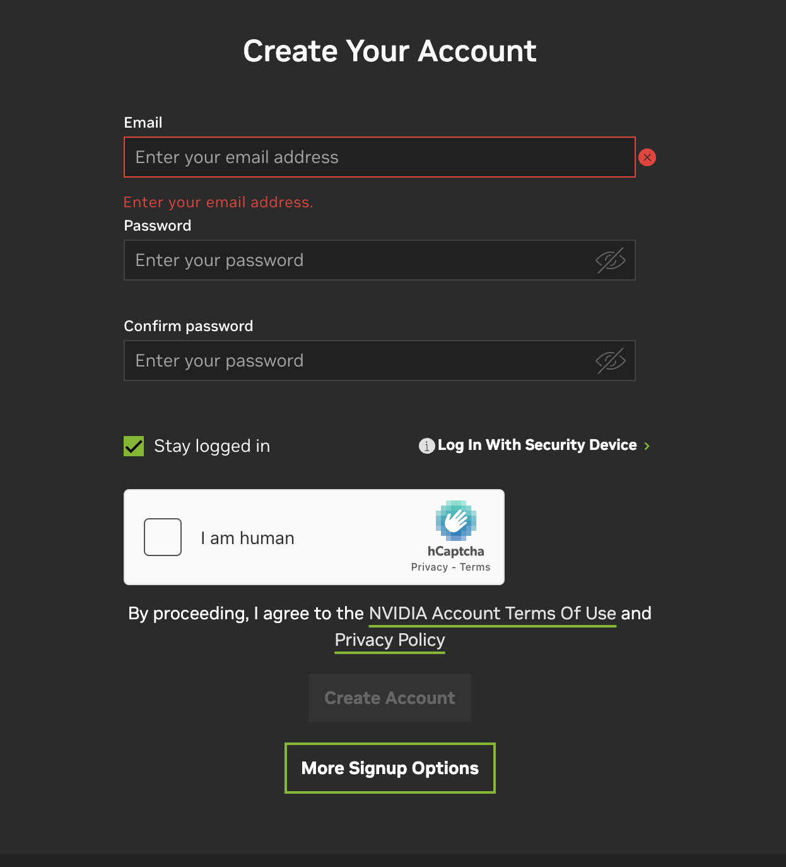
Logistics
brev.nvidia.com
Go to this URL - https://tinyurl.com/casml-nvidia
Signup with your email

Slide 5
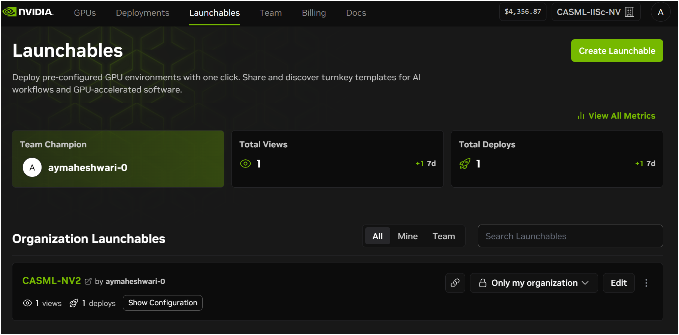
Click on Launchables
1. Click on this tab
2. Click here

Slide 6
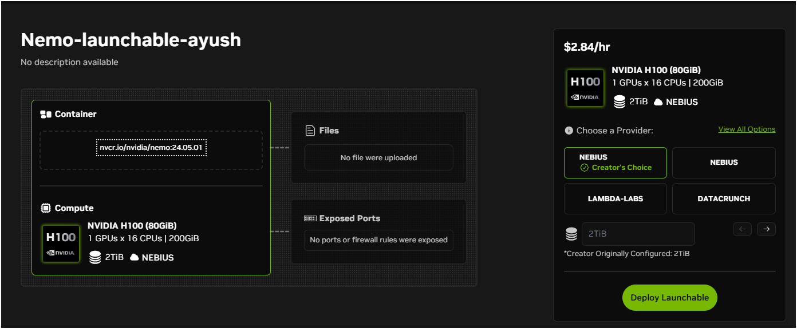
Deploy Launchable
1. If instance, doesn’t spin: Refresh the page and/or Change the provider
2. Click here

Slide 7
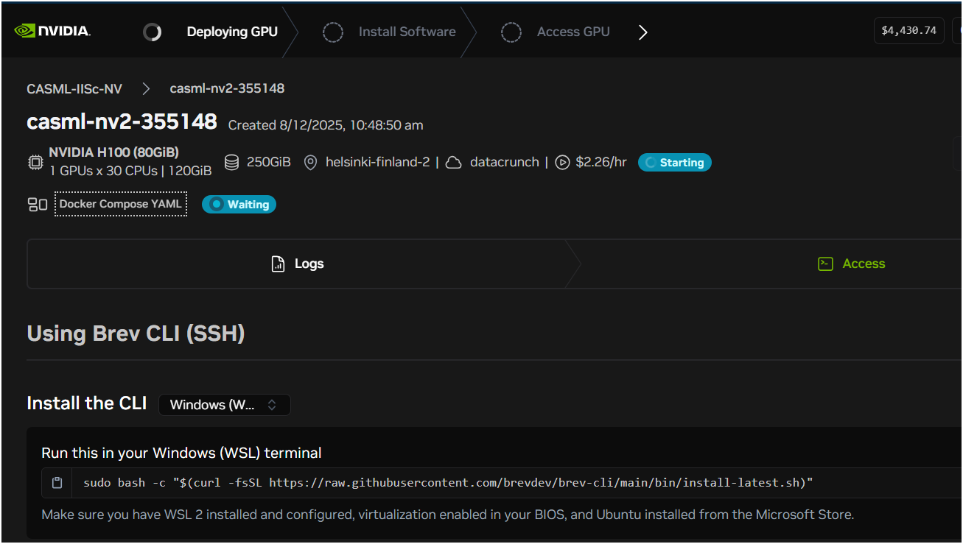
This will take ~10 minutes depending on provider and number of requests.

Slide 8
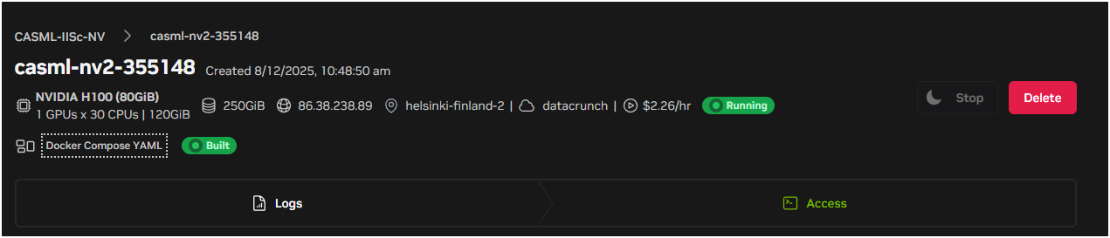
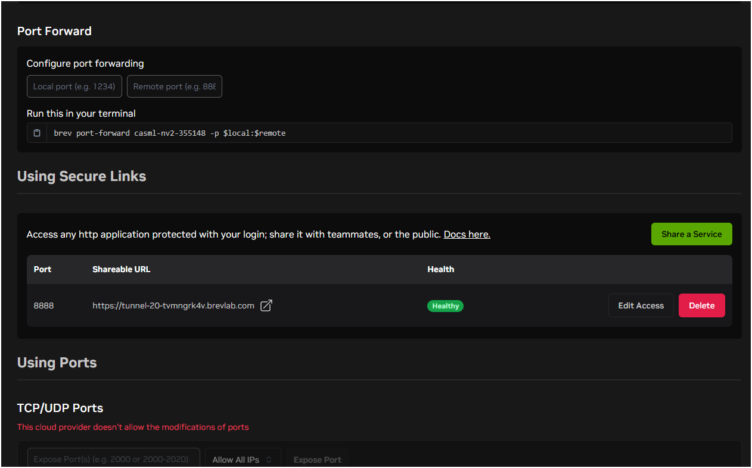
In Access tab, scroll and click here

Slide 9
Understanding the hardware (30 mins)
GPU vs CPU
GPU communication primitives
System Topology
Part 1

Slide 10
Why should you care?
Understand the hardware and its performance on multiple GPUs.
Ensure that your training performance aligns with the h/w benchmarks
Evaluate the cluster to ensure platform fits within your needs.
Take advantage of new techniques for multi-GPU computing.
Effective Performance (Training/Inference) Througput/Latency
Computation TFlops
Communication GB/s
Notes:
To get the most out of multi-GPU clusters, we need to understand how our hardware actually performs in real-world deep learning workloads. For example, using NCCL, NVIDIA's Collective Communication Library, if we have 8 A100 GPUs connected by NVLink, NCCL can achieve extremely fast communication for synchronizing gradients during model training. This means less waiting time between GPUs and faster overall training.
It's not enough to just buy fast GPUs—we need to verify that our actual AI training workloads are matching up to hardware potential. For instance, MLPerf is an industry-standard benchmark that simulates large-scale AI training. If public MLPerf numbers show that GPT-3 can be trained in 20 minutes on 256 H100 GPUs, but our cluster needs 40 minutes, then something's off—maybe a network bottleneck or software inefficiency. Before settling on a particular cluster, it's important to evaluate whether the platform matches our workload requirements. For example, if we know our model requires a lot of inter-GPU communication, we should check NCCL's throughput benchmarks on that cluster. If the cluster has published MLPerf results, like "BERT trained in 15 minutes on 32 nodes," and that's aligned with our needs, that's a good sign. It’s also useful to do a small scaling test ourselves: try training a mini-version of our model and see how close our results are to vendor or public benchmarks.

Slide 11
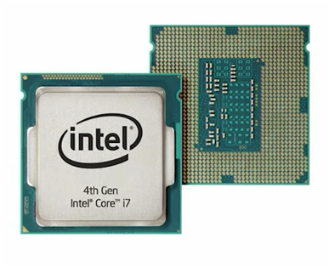
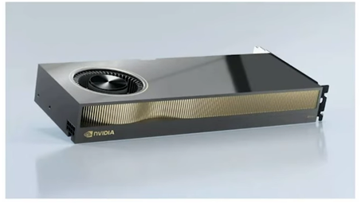
1 floating point operation
Seconds ??
Seconds ??

Slide 12
1 floating point operation
~1ns
~1µs

Slide 13
2048 x 2048 matmul
Seconds ??
Seconds ??

Slide 14
2048 x 2048 matmul
28ms
.2ms (200µs)

Slide 15



Different Objectives
GPU Accelerator
Optimized for
Parallel Tasks
CPU
Optimized for
Serial Tasks
This material is released by NVIDIA Corporation under the Creative Commons Attribution 4.0 International (CC BY 4.0)
Notes:
Back in the past, I once had a seemingly silly question: Which is more important between the CPU and GPU, or when buying a computer, should we prioritize the CPU or the GPU.
CPU is like a high-performance sports car with a tremendously powerful engine, while the GPU is like an extra-long bus designed to transport passengers. If only a small number of passengers need transportation, the CPU will be faster, but when the number of passengers is high, the GPU becomes an excellent choice.
CPU processes complex tasks but in smaller quantities. GPU processes numerous tasks but are much simpler

Slide 16
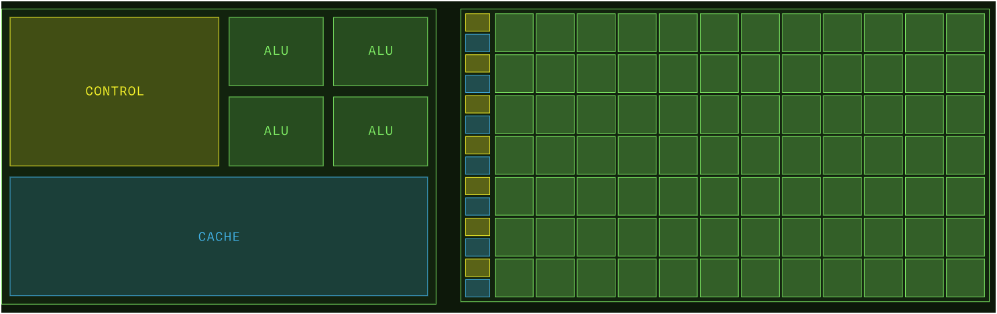
CPU vs GPU
Latency vs Throughput-oriented Design
Src: modal.com
Notes:
CPUs and GPUs are designed with two different objectives. CPU is designed with a small number of high-quality, powerful, and efficient cores. These cores can be considered multitasking (for example: executing application tasks, managing resources, controlling the system, processing information, etc.). Large Control Unit: Optimizes the control of complex logic operations (AND, OR, XOR, etc.). Large Cache: Helps reduce data access time. Therefore, the CPU tends to prioritize using Cache and control.
GPUs (Graphics Processing Units) are designed with a high number of cores, even though these cores might be of lower quality compared to CPU cores. a significant portion of the area is occupied by compute units or cores: Resulting in faster computations, thus demanding a steady supply of data. To meet this data computation requirement, GPUs are designed with an architecture that enhances bandwidth, making data transfer faster, and also equipped with larger memory

Slide 17
Silicon Budget
Less
ALU
More
More
Control
Less
More
Cache
Less
Notes:
Arithmetic Logic Unit
Impacts how the silicon on the chip is assignd

Slide 18
CPU is a latency reducing architecture
CPU Strengths
Very large main memory
Very fast clock speeds
Latency optimized via large caches
Small number of threads can run very quickly
CPU Weaknesses
Relatively low memory bandwidth
Cache misses very costly
Low performance/watt
GPU Accelerator
Optimized for
Parallel Tasks
CPU
Optimized for
Serial Tasks
Notes:
Let’s look at some of the key differences between CPUs and GPUs
As we have seen over the last 15 years or so, as the increases in individual thread performance of CPUs has been stalling, in order to try to counter this CPUs have moved to an increasingly multicore architecture, with latest CPUs having up to 128 cores with fast clock speeds. They also have a large main memory, we see servers now with Terabytes of RAM, but the bandwidth of that memory i.e. how quickly we can move data about, is relatively low.
CPUs are designed to run multiple different applications at once, such as running an operating system with all the associated services, or running your word processor alongside a browser etc. Individually these tasks and applications are essentially serial in nature, so each of these applications is assigned to a single thread or a small number of threads, and these are scheduled in a timesliced manner to run on the CPU. Then, a given thread must get a much as possible accomplished during it’s timeslice.
This requires low latency i.e. we want to minimize the delay between issuing a request for data and actually executing the instruction on the data, which implies large caches to hold the data required by the threads, and complex control logic to ensure for example that the data is ready to go when the thread is running. One consequence of this is that a large amount of the silicon on a CPU is dedicated to this movement and pre-fetching of data, which means that CPUs have relatively low performance per watt, as a significant proportion of the energy is used for this data movement rather than actual calculations. In addition cache misses, i.e. trying to access data which isn’t already in the cache, can be very costly.

Slide 19
GPU is all about hiding latency
GPU Strengths
High bandwidth main memory
Significantly more compute resources
Latency tolerant via parallelism
High throughput
High performance/watt
GPU Weaknesses
Relatively low memory capacity
Low per-thread performance
GPU Accelerator
Optimized for
Parallel Tasks
CPU
Optimized for
Serial Tasks
This material is released by NVIDIA Corporation under the Creative Commons Attribution 4.0 International (CC BY 4.0)
Notes:
Let’s look at the GPU in comparison, which is optimized for executing highly parallel tasks – stemming from its roots in generating actual computer graphics, where one can imagine the same operation being applied to millions of pixels multiple times a second in order to render scenes.
Modern GPUs have a huge number of compute cores, over 10000 for some of the latest cards, but these compute cores are much more lightweight – they don’t have the complex logic for pre-fetching data for example. So instead, the GPU deals with the issue of latency by hiding it with computation – essentially we give the GPU much more work to do than there are physical cores to execute it, a very different approach to the CPU.
The scheduler on the GPU launches a thread, that thread tries to execute an operation, such as an addition for example – if the data is not there ready for the thread to use, it issues a fetch command to memory, and it stalls while waiting for the data to arrive. The scheduler then moves on to another thread to execute it’s instructions and so on and so on, creating a pipeline of issued instructions across a series of threads. Eventually the original thread’s data is ready and then it is able to continue execution. This switching between threads hides the latency of the memory fetching and issuing of instructions, and thus the more work we can give the GPU to do, the easier it is for the scheduler to hide this latency, so we need many overlapping concurrent threads,This is a core difference to how we program for the CPU where we usually match one or two threads to a compute core. To support this the GPUs have a very large register file to hold the state of the threads, and switching between them happens at no time penalty, even as often as every clock cycle. As such the significant majority of the silicon on a GPU is given over to computation rather than data movement, giving them very efficient performance per watt.
In addition the GPUs have very high bandwidth main memory compared to a CPU, and many applications are bandwidth bound rather than compute bound so this can also deliver significant performance improvements. The additional bandwidth though comes at a cost, with the GPU memory being significantly faster but relatively smaller, for example the latest A100 card has an 80GB version, large for a GPU but small compared to the CPU, however it runs at a massive 2TB/s bandwidth, pretty much an order of magnitude faster than the CPU memory.
Something else to consider with GPUs is the precision that we want to use for our simulations – the compute cores are often dedicated to calculations at a particular precision such as integers or single precison, so different GPUs may have more or less of these – for example V100 and the new A100 would cards are ideal for double precision calculations as they have a large amount of the double precision cores., whereas the RTX cores are aimed at single precision performance.

Slide 20
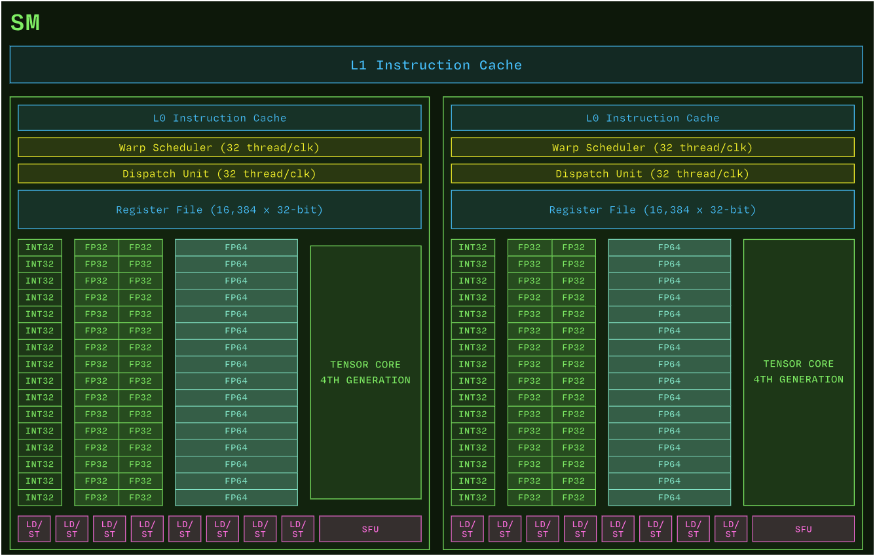
Src: modal.com
Notes:
An H100 SXM GPU draws at most 700 W and has 132 SMs, each of which has four Warp Schedulers that can each issue instructions to 32 threads (aka a warp ) in parallel per clock cycle, for a total of 128 × 132 > 16,000 parallel threads.
For comparison: an AMD EPYC 9965 CPU draws at most 500 W and has 192 cores, each of which can execute instructions for at most two threads at a time, for a total of 384 threads in parallel
Streaming Multiprocessors (SMs) of NVIDIA GPUs are roughly analogous to the cores of CPUs. That is, SMs both execute computations and store state available for computation in registers, with associated caches. Compared to CPU cores, GPU SMs are simple, weak processors.
GPU SMs also support a large number of concurrent threads -- threads of execution whose instructions are interleaved

Slide 21
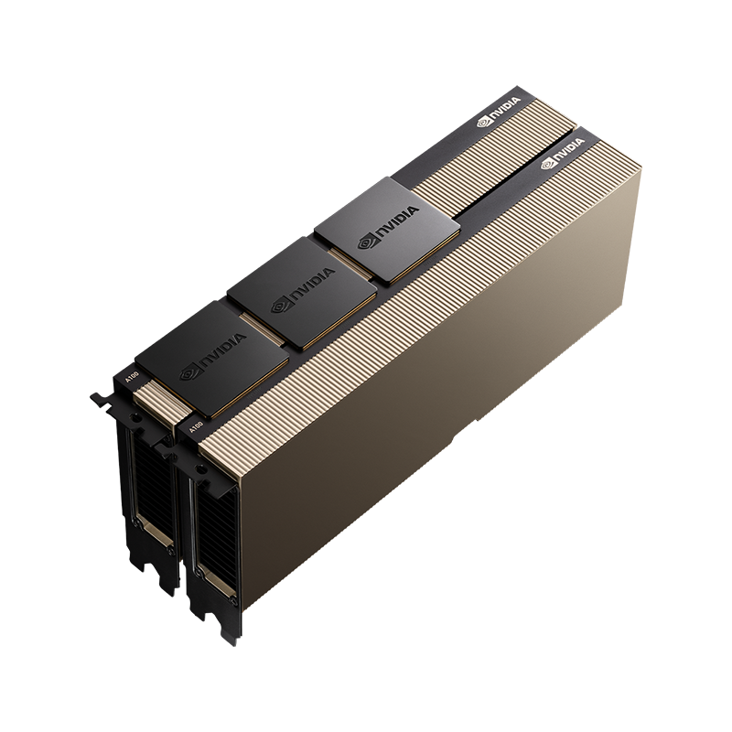
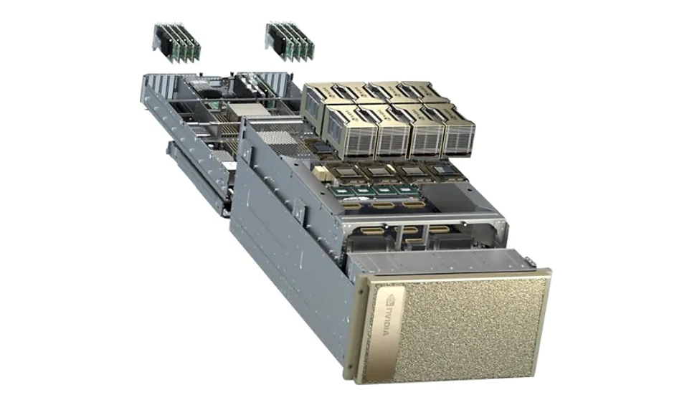
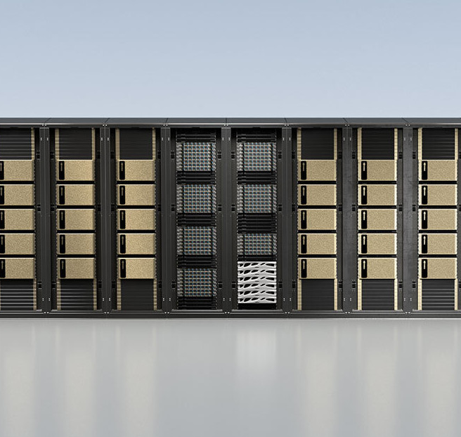
Multi-GPU Computing
NCCL: NVIDIA Collective Communication Library
Inter-GPU communication on PCI, NVLink, IB/RoCE, and other networks.
PCI Server
DGX/HGX
Large systems
Notes:
NVIDIA Collective Communications Library (NCCL, pronounced “Nickel”) is a library providing inter-GPU communication primitives that are topology-aware and can be easily integrated into applications. NCCL handles core operations like all-reduce, all-gather, reduce-scatter, crucial for large-scale distributed deep learning. It supports communications over a variety of interconnects: PCIe, NVLink, InfiniBand (IB), RoCE, and sockets, dynamically detecting and using the fastest available pat

Slide 22
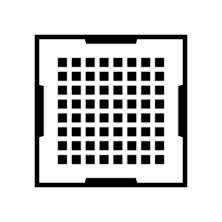
Multi-GPU Computing in DL
Data Parallelism / FSDP
All-reduce, all-gather, reduce-scatter
Tensor Parallelism
All-reduce, all-gather, reduce-scatter
Pipeline Parallelism
Send / receive
Expert Parallelism
All-to-all

Slide 23
Communication primitives
Reduce-scatter
Notes:
During large-scale training (like with ZeRO or Fully Sharded Data Parallel), model gradients are split among GPUs. Each GPU reduces (sums) its assigned piece of the gradients with others, then only stores its piece. This saves memory and communication bandwidth, making it possible to train bigger models without every GPU needing a copy of everything

Slide 24
Communication primitives
All-gather
Notes:
When a model layer's parameters are sharded across GPUs for efficiency, before a computation that needs the full layer (like a forward pass), an all-gather step collects all parameter shards so every GPU can proceed. This is widely used in sharded data-parallel and tensor-parallel LLM training setups.

Slide 25
Communication primitives
All-reduce
Notes:
In distributed training for data parallelism, each GPU processes its own minibatch and computes a set of gradients.
To ensure the model parameters are updated identically on every GPU, these gradients must be summed (or averaged) across all GPUs before updating.
All-Reduce efficiently performs this sum: every GPU sends out its gradients, they’re summed up collectively, and the result (the global average or sum) is sent back so every GPU gets the final combined gradients.
In frameworks like PyTorch or TensorFlow, this is managed via libraries (e.g., NCCL on NVIDIA GPUs) that optimize All-Reduce to minimize communication overhead, using topologies like "ring", "tree", or "hierarchical" patterns depending on hardware and batch size

Slide 26
Communication primitives
All-to-all
Notes:
all-to-all is a more general—and communication-intensive—pattern. Here, each GPU has a unique piece of data for every other GPU, and every GPU sends and receives a separate piece from all others. The results on each GPU are not globally summed or combined; rather, data are flexibly exchanged so that each GPU ends up with a different set of data from different sources. This is required for parallelism approaches like Expert Parallelism, where different inputs might need to reach specific experts on different GPUs

Slide 27

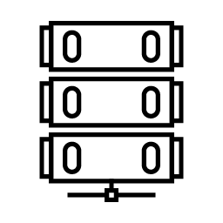
All-to-all Communication Bandwidth
Multi-GPU PCI NVLink
Multi-node IB/RoCE NVLink
NCCL Tests Alltoall Bus Bandwidth in GB/s, 8 GPUs
NCCL Tests Alltoall Bus Bandwidth in GB/s, 32 GPUs

Slide 28
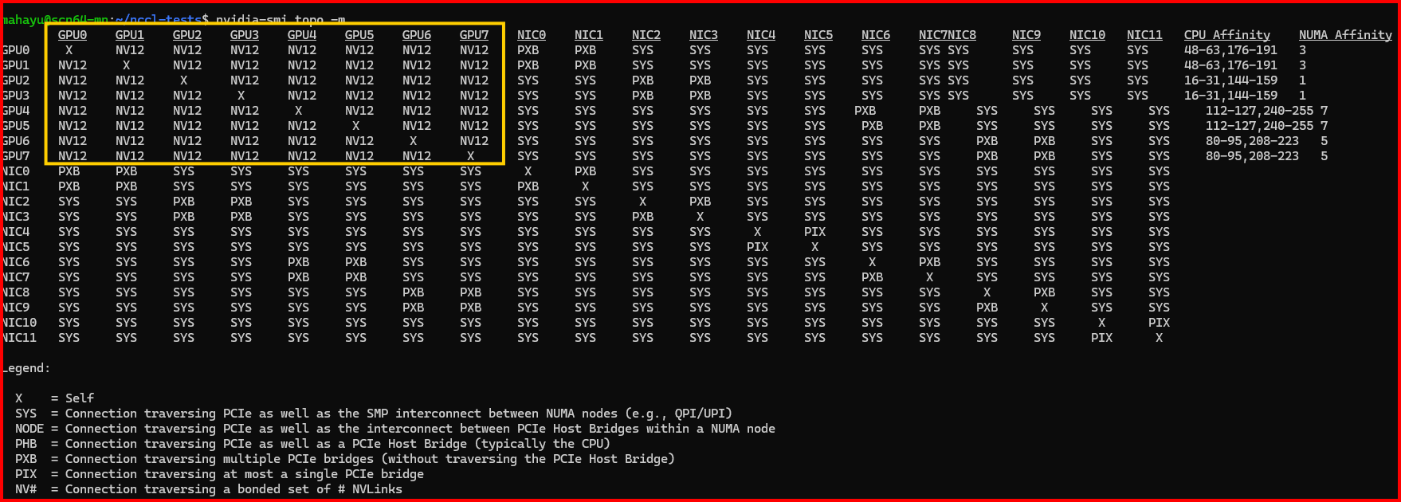
Checking System Topology (A100)
`nvidia-smi topo –m`
Notes:
Each NVIDIA GPU is equipped with 12 NVLink third generation links in A100 with bi-directional bandwidth of 50 GBps.
These links do not directly connect each GPU to every other GPU with a dedicated, point-to-point link.
Instead, all GPUs are connected through NVSwitch ASICs which specialized switch chips designed to provide full-bandwidth, all-to-all GPU communication. The NVSwitches act as crossbar switches, not simple pass-throughs.
This allows any GPU to communicate with any other GPU at full NVLink speed, using the switch fabric to efficiently route data.

Slide 29
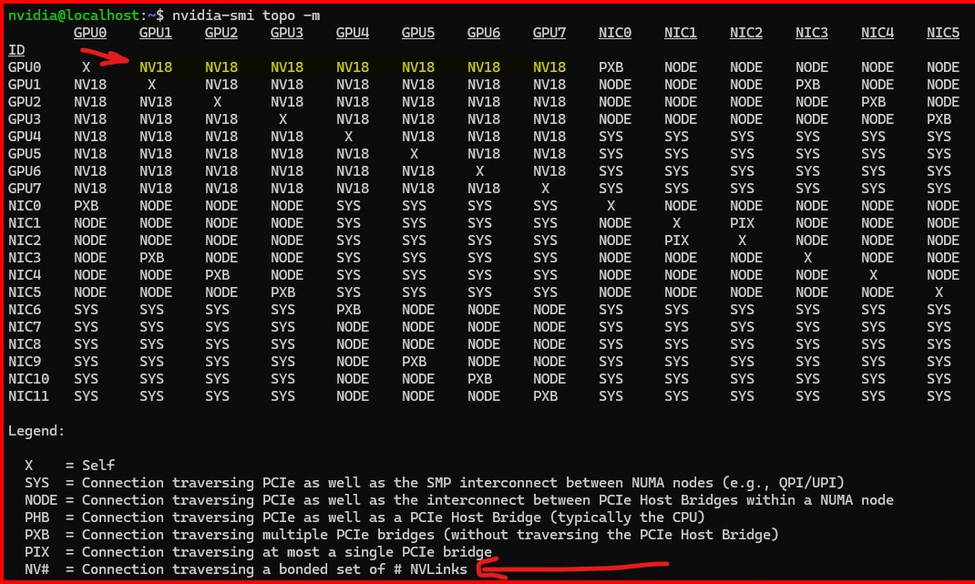
Checking System Topology (H100)
`nvidia-smi topo –m`

Slide 30
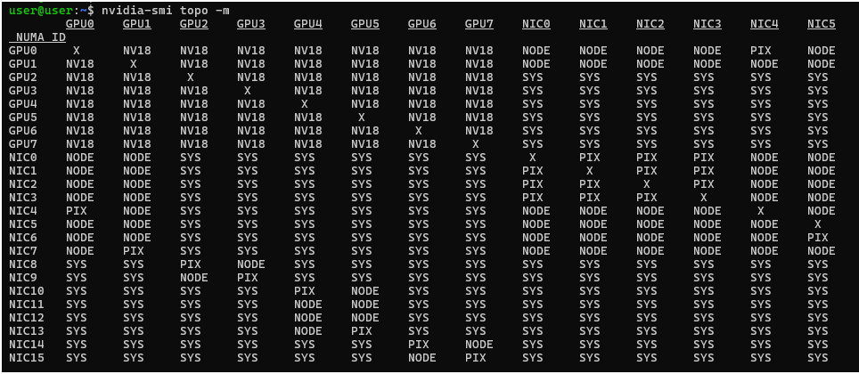
Checking System Topology (B200)
`nvidia-smi topo –m`

Slide 31
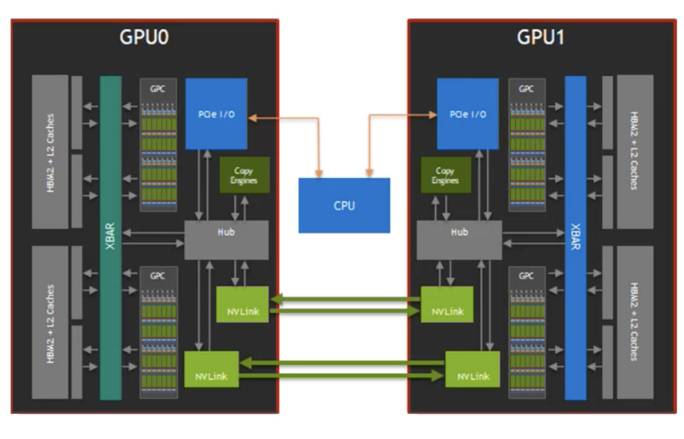
What is NVLINK?
GPU-to-GPU, CPU-to-GPU High Bandwidth Communication
NVLINK development start in 2013
High speed interconnect technology enabling direct GPU-to-GPU communication, bypassing PCIe bottlenecks.
NVLink allows faster data transfer, higher bandwidth, and lower latency between GPUs
Supports various memory transactions
Cacheable (coherent) / Non – cacheable (non-coherent) transaction support
Parallelizable
Unification of HBMs memories across a pool of GPUs
Switchable
Notes:
Unlike traditional PCIe, which quickly becomes a bottleneck in multi-GPU systems, NVLink provides much higher bandwidth and lower latency—up to 900GB/s in the latest versions.
By letting GPUs talk to each other directly via NVSwitch, NVLink drastically improves the speed of data transfer, which means our deep learning, simulation, or analytics workloads can run faster and scale better.
NVLink supports both cache-coherent (where memory changes on one GPU are instantly visible to others) and non-coherent (uncached or manual sync) transactions. NVLink allows pooling the memory of all attached GPUs, letting applications see and use a larger effective combined memory space.
For example, two GPUs with 80GB HBM2e each, when linked via NVLink, can be programmed to act like a unified 160GB pool, helping fit larger models or dataset
NVSwitch enables all-to-all GPU communication by interconnecting multiple NVLink-capable GPUs within a system, supporting up to hundreds of GPUs in a fabric—used in DGX SuperPODs and similar clusters. For example, in an 8-GPU NVIDIA DGX A100 server, NVLink provides 600GB/s of bi-directional bandwidth, and all GPUs can share data seamlessly. During training of a large language model, each GPU can access data in another's memory almost as fast as its own, massively speeding up collective operations like all-reduce or model parallelism

Slide 32
Ring Algorithm
Input0
Input1
Input2
Input3
Output0
Output1
Output2
Output3
Notes:
Ring and Tree Algorithm
Ring Algorithm Reduce-Scatter (Ring): Each device splits its data into N chunks (N = # devices). In each step, every device sends one chunk to its neighbor and receives a chunk from another neighbor. Each received chunk is combined (reduced) with its local data. This repeats for N−1 rounds, so every device ends up with a distinct chunk of the reduced data. All-Gather (Ring): Now, each device holds a unique reduced chunk. Through N−1 rounds, devices keep sending their chunks around the ring. After all rounds, every device has received each chunk and holds the entire result.

Slide 33

Tree Algorithm
6
7
4
5
2
3
0
1
Tree #1
Tree #2
Input A
Input B
Input C
Input D
GPU A Node 7
GPU A Node 2
NIC A Node 3
GPU A Node 1
GPU A Node 5
Output A
Output B
Output C
Output D
Notes:
b) Tree Algorithm (Example: All-Reduce, All-Gather) Data is aggregated (reduce) or distributed (gather/broadcast) following tree steps: In each round, the number of devices involved doubles (log₂N rounds). For reductions, data is sent "up" toward the root, combining at each step. For gathering, complete data is pushed "down" to all leaves. Used when minimizing the number of communication steps (latency) is more critical than bandwidth.

Slide 34
Collective Communication Bandwidth
Multi-GPU NVLink
Multi-node IB/RoCE NVLink
NCCL Tests Allreduce Bus Bandwidth in GB/s, 8 GPUs
NCCL Tests Allreduce Bus Bandwidth in GB/s, 32 GPUs

Slide 35
Collective Communication Bandwidth
Multi-GPU NVLink
Multi-node IB/RoCE NVLink
NCCL Tests Allreduce Bus Bandwidth in GB/s, 8 GPUs
NCCL Tests Allreduce Bus Bandwidth in GB/s, 32 GPUs

Slide 36
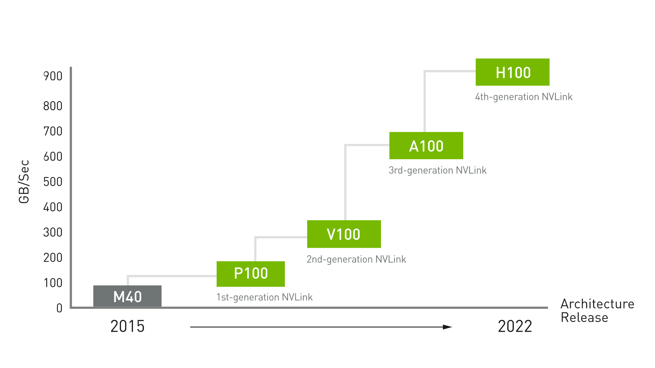
Evolution of NVLINK
(v1.0 to v5.0)
NVLink 1.0: Introduced 20 GB/s bandwidth per GPU link, improved over PCIe.
NVLink 2.0: Increased to 25 GB/s per link, added enhanced coherency.
NVLink 3.0: 50 GB/s per link, improved scaling in multi-node environments.
NVLink 4.0: 100 GB/s per link, reduced latency, supported larger clusters.
NVLink 5.0: Up to 900 GB/s aggregate bandwidth, lower latency, optimized for AI and HPC, improved multi-node communication and scaling.

Slide 37
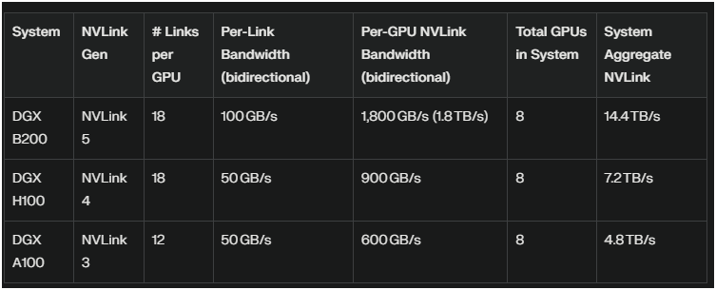
NVLink Evolution
Intra-node Connectivity

Slide 38
Agenda
• | Multi-GPU Computing in DL
• | Hardware and Performance
• | How-to-NCCL
• | MLPerf Benchmarks
• | HPL

Slide 39
NCCL
The NVIDIA Collective Communications Library (NCCL, pronounced “Nickel”) is a library for inter-GPU communication.
NCCL test is an open-source software to benchmark inter-GPU communication speed.
When you run deep learning across multiple GPUs, you care about the communication speed among those GPUs.
By running NCCL tests with various configs, you can check if your hardware can reach the designed performance for each config setting.

Slide 40
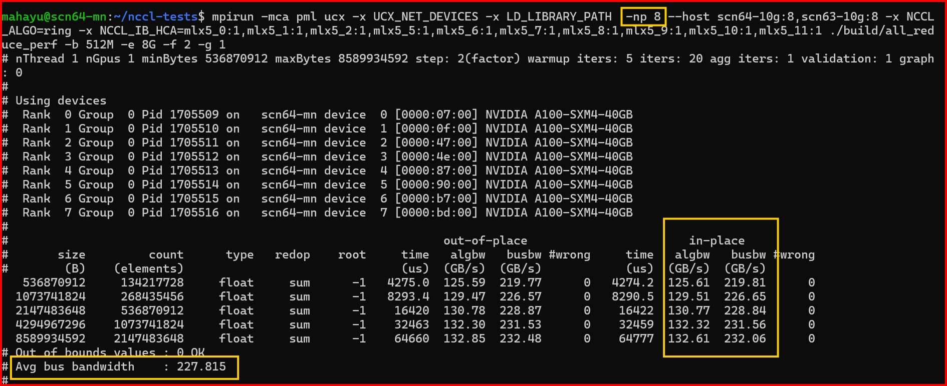
NCCL Output
A100 (Single Node)

Slide 41
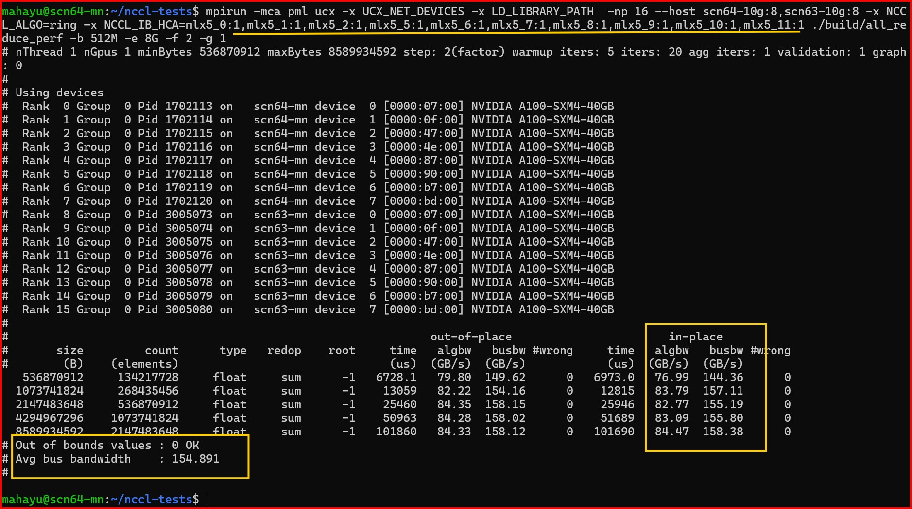
NCCL Output
A100 (Multi Node)

Slide 42
NCCL Interpretation
Operation Time - NCCL tests report the average time (in milliseconds) it takes to complete a collective operation
Algorithm Bandwidth (algbw) - How much data (in GB) is being processed per second by the algorithm. For point-to-point operations (like Send/Receive), this is meaningful and directly reflects throughput.
Bus Bandwidth (busbw) - It adjusts the algorithm bandwidth to reflect the actual hardware bottleneck (e.g., NVLink, PCIe, network), making it possible to compare results regardless of the number of ranks.
Verify NCCL results by finding peak theoretical bandwidth for
Intra-node: NVLink
Inter-node: Infiniband/Connect-X Ethernet
Run NCCL using slurm or mpirun
Notes:
NCCL reports two types of bandwidth for each test:
Algorithm Bandwidth Tells you how much data (in GB) is being processed per second by the algorithm. For point-to-point operations (like Send/Receive), this is meaningful and directly reflects throughput.
Bus Bandwidth (busbw) is needed for collective operations (involving multiple GPUs/ranks), algorithm bandwidth doesn’t always reflect the true hardware utilization, especially as the number of ranks increases. The theoretical peak for collective operations depends on both the hardware and the number of ranks participating. Bus bandwidth adjusts the algorithm bandwidth to reflect the actual hardware bottleneck (e.g., NVLink, PCIe, network), making it possible to compare results regardless of the number of ranks.

Slide 43
NCCL Demo

Slide 44
Agenda
• | Multi-GPU Computing in DL
• | Hardware and Performance
• | ML Perf Benchmarks
• | HPL for effective GEMM
• | Summary

Slide 45
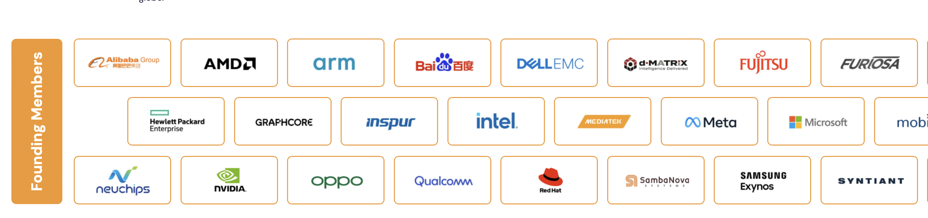
What is MLPerf?
Unbiased AI benchmarks negotiated by a consortium
MLPerf™ benchmarks—developed by MLCommons, a consortium of AI leaders from academia, research labs, and industry—are designed to provide unbiased evaluations of training and inference performance for hardware, software, and services. They are all conducted under prescribed conditions.
…

Slide 46
How-to-MLPerf
https://docs.mlcommons.org/inference/
MLPerf v5.0 (latest) for training and inference
Reported Benchmark Performance - https://mlcommons.org/benchmarks/inference-datacenter/
Running Inference – git clone https://github.com/mlcommons/inference_results_v5.0
Requirements for running NVIDIA reported benchmarks on DGX systems
TRT-LLM – Generate optimized TRT engine

Slide 47
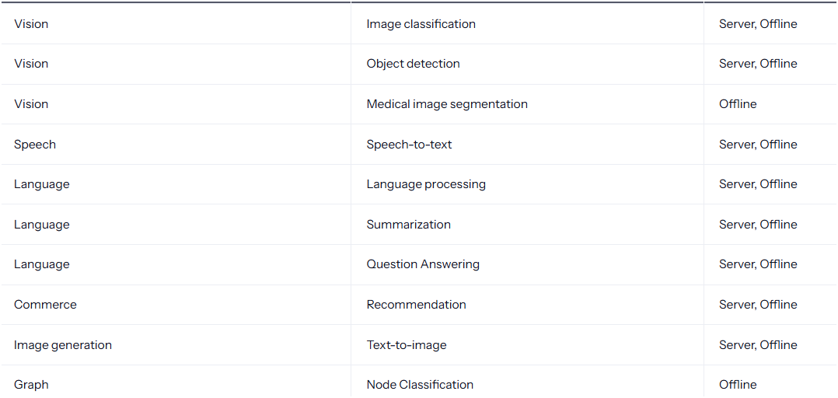

Slide 48
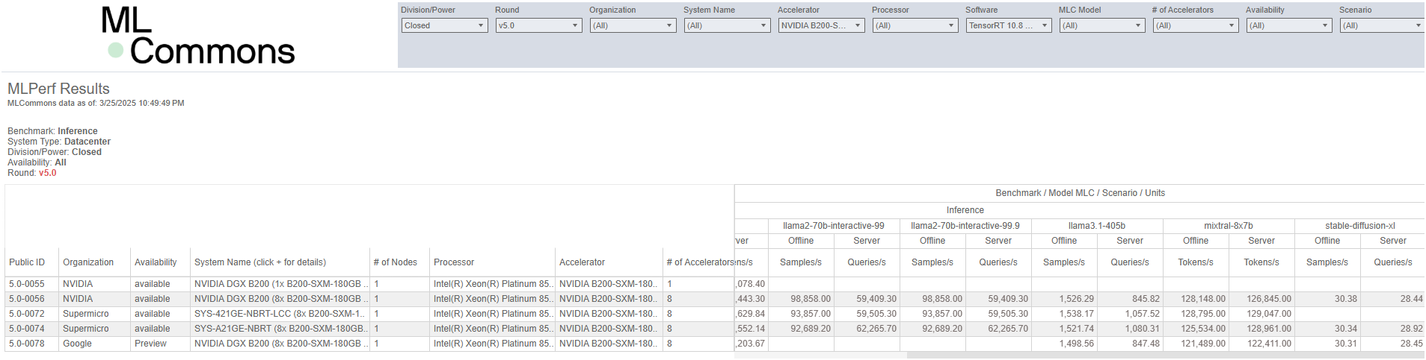
MLCommons
https://mlcommons.org/benchmarks/inference-datacenter/

Slide 49
Agenda
• | Multi-GPU Computing in DL
• | Hardware and Performance
• | ML Perf Benchmarks
• | HPL for effective GEMM
• | Summary

Slide 50
HPL Algorithm Overview
What is HPL?
HPL is a software package that solves a dense linear system of equations in double precision(64-bit) arithmetic on distributed memory computers
HPL is an implementation of the Linpack code – which measures the single machine’s performance. Thus, HPL implements this at scale
The goal is to measure the system’s rate of execution of 64-bit Floating point arithmetic
HPL result is a single number in Floating Point Operations Per Second (FLOPS)
Notes:
HPL (High Performance Linpack) is a benchmarking tool used to evaluate the floating-point computational performance of a system.
It is part of the Linpack benchmark suite, which is widely used in the scientific and engineering communities to assess the performance of supercomputers and parallel computing systems. It is used for ranking systems on the TOP500 list and serves as a critical test for the scalability and efficiency of parallelized hardware and software.
HPL is primarily used to benchmark the performance of supercomputers, clusters, and other high-performance systems in solving large systems of linear equations (Ax = b). This is a core computational task in many scientific, engineering, and research applications.

Slide 51
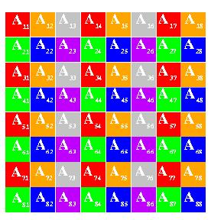
HPL Algorithm Overview
Like in reference HPL (+other implementations) matrix is 2D block cyclic.
We typically prefer larger matrix blocks, i.e. NB = O(1000).
The main computation is now entirely on the GPU:
Various kernels (factorization, NCCL comm, GEMM, TRSM share SM resources)
We use a variety of communication libraries – NCCL/MPI/NVSHMEM.
For some comms operations, NCCL is the only library used (e.g. panel broadcast).
For other operations, there are several options (tuning for best perf depending on scale)
Parameter file only used to specify N/NB/P/Q/PMAP
Most ‘advanced’ tuning done by environment variables.
Q=3
P=2
Notes:
tests the system's ability to solve a set of dense linear equations using a parallelized version of the Gaussian elimination method. The algorithm is based on the solution of a large system of linear equations of the form:
Ax=b
Where A is a large square matrix, x is the solution vector, and b is the right-hand side vector. The core of the algorithm is the LU decomposition (also known as LU factorization), which decomposes the matrix A into the product of a lower triangular matrix L and an upper triangular matrix U. This factorization is then used to solve the system of equations.

Slide 52
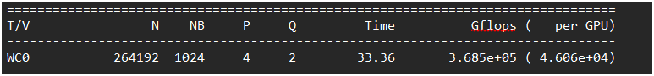
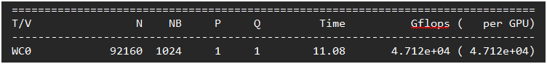
HPL Performance
H100
Notes:
Main parameters to update are P, Q, N, NB.
P : The number of processes to distributed the row blocks over Q : The number of processes to distribute the column blocks over
N : The global matrix size The more number of nodes, higher the N value is.
NB : The matrix block size NB determines the size of the data blocks that are used when dividing the large matrix into the smaller chunks of processing.

Slide 53
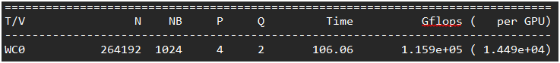
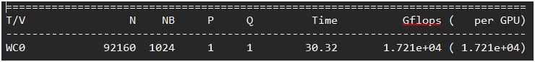
HPL Performance
A100
Notes:
Main parameters to update are P, Q, N, NB.
P : The number of processes to distributed the row blocks over Q : The number of processes to distribute the column blocks over
N : The global matrix size The more number of nodes, higher the N value is.
NB : The matrix block size NB determines the size of the data blocks that are used when dividing the large matrix into the smaller chunks of processing.

Slide 54
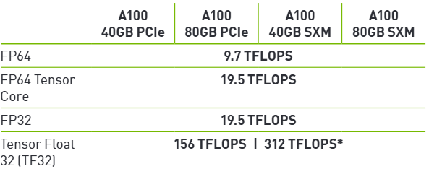
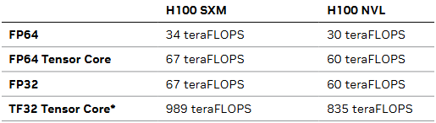
Compare HPL Performance
Refer datasheet of respective GPUs to see peak theoretical TFlops
https://resources.nvidia.com/en-us-gpu-resources/h100-datasheet-24306

Slide 55
Summary
Scripts - https://github.com/ayushbits/llm-development
NCCL test for analysing intercommunication within and among multiple servers.
Essential for optimizing distributed training throughput and scalability.
MLPerf: Industry-standard benchmark for end-to-end machine learning workloads.
Evaluates real-world AI training and inference efficiency across platforms.
HPL : Assesses peak floating-point computing power (FLOPS) of CPU and GPU clusters.
Validates overall system performance for high-performance computing tasks.

